Slide 1
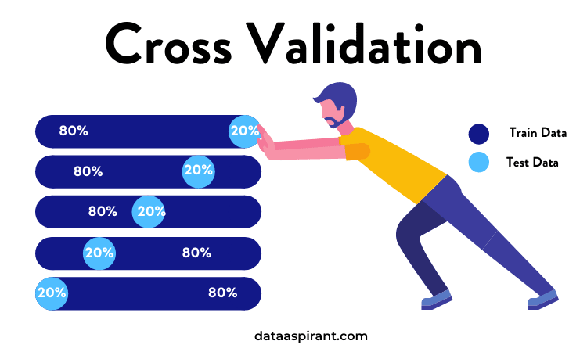
Cross Validation
-Mainak Dev

Slide 2
Suppose we want to use the variables (Chest Pain, Good Blood Circulation,) etc.. to predict if someone has a heart disease
We can use this data to predict whether a new patient has heart disease or not
Chest Pain | Good Blood Circulation | Blocked Arteries | Weight | Heart Disease
No | No | No | 125 | No
Yes | Yes | Yes | 180 | Yes
Yes | Yes | No | 210 | No
… | … | … | … | …
Chest Pain | Good Blood Circulation | Blocked Arteries | Weight | Heart Disease
Yes | No | No | 168 | ???
Before we can do this we have to decide which machine learning method would be the best

Slide 3
We could use Logistic Regression…
or K-nearest neighbours
and many more machine learning algorithms, how do we decide which one to use?
Cross Validation allows us to compare different machine learning methods and get a sense of how well they will work in practice
or support vector machines(SVM)

Slide 4
Let's imagine this blue box represents all the data that we have collected about people with or without heart disease
We need to do two things with this data
Estimate the parameters for the machine learning methods
In other words to use Logistic regression we have to use some of the data to estimate the shape of this curve…
In machine learning we call this "training the algorithm"
Evaluate how well the machine learning methods work
In other words we need to find out if this curve will do a good job categorizing new data
In ML we call this "testing the algorithm"
To summarize using machine learning we need the data to:
Train the machine learning methods
Test the machine learning methods

Slide 5
A terrible approach would be to use all of the data to estimate the parameters(i.e train the algorithm) then we would not have any data to test the methods. Reusing the same data to train and test ML model is a bad idea because we need to know how the method will work on the data it was not trained on

Slide 6
A Slightly better idea would be to use the first 75 % of the data for training and the last 25% of the data for testing
Training
Testing
We can then compare each ML method to see how well each algorithm categorized the test data

Slide 7
How do we know that using the first 75% of the data for training and the last 25% of the data for testing is the best way to divide up the data?

Slide 8
Rather than worrying too much about which block would be best for testing, Cross validation uses them all one at a time and summarizes the results at the end.
For example cross validation will initially use the first three blocks to train the method and use the last block to test the method
Training
Test Data categorization
Correct Incorrect
5 1
Testing

Slide 9
Rather than worrying too much about which block would be best for testing, Cross validation uses them all one at a time and summarizes the results at the end.
For example cross validation will initially use the first three blocks to train the method and use the last block to test the method
Training
Test Data categorization
Correct Incorrect
4 2
Testing
Then it uses the next combination to train and test the data. And keeps repeating this thill all combination are accounted for.

Slide 10
In the end, every block of data is used for testing and we can compare methods by seeing how well they performed.
Logistic Regression
Support Vector Machines(SVM)
K-nearest neighbours
Correct Incorrect
5 1
Correct Incorrect
18 6
Correct Incorrect
10 12

Slide 11

In this example we divided the data into 4 block. This is called "Four Block Cross Validation"
The number of blocks is arbitrary
In an extreme case, we could call each individual data (or sample) a block. This is called "Leave One Out Cross Validation"
Ideally it is pretty normal to divide the data into ten block, this is called "Ten Fold Cross Validation"
Note: For calculating the tuning parameter( ) in Lasso & Ridge regression we use Ten Fold Cross Validation

